Slide 1
Transmit Power Optimization on Disguised Full-Duplex Covert Communications
2024.04.26
THE 34th JOINT CONFERERENCE ON COMMUNICATIONS AND INFORMATION
Refat Khan, *Jihwan Moon
Department of Mobile Convergence Engineering, Hanbat National University

Slide 2
Table of Contents
Introduction
System Model
Problem Formulation
Proposed Solution
Numerical Result
Conclusion

Slide 3
Introduction
Securing Wireless Communication:
Wireless technology transforms lives, but cyberattacks pose a threat, leading to potential information leaks.
To cope with this, cryptography has widely been adopted.
Yet, it has limitations: complex key generation and susceptibility to powerful eavesdroppers, especially challenging for IoT devices.
These downsides have led researchers to examine the possibility of utilizing physical layer security.
Its key feature is the ability to block wireless links to eavesdroppers using techniques like nullifying beamforming or introducing artificial noise.

Slide 4
Introduction
Challenges of Secure Communication:
Security Threats:
Opponents can conduct traffic analysis by collecting metadata during transmission.
Vulnerabilities include capturing source and destination addresses, request-response frequency, etc
Need for Covert Communications:
Transmit data in a manner that avoids detection or suspicion.
Combining cryptography and physical layer security can prevent eavesdropping, but covert communications are necessary to counter traffic analysis threats.

Slide 5
Introduction
Investigating Covert Communications:
System Overview:
Setup involves a source node and disguised full-duplex (FD) destination node.
Objective:
Ensure covert transmission to a hidden receiver without warden node surveillance.
Research Scope:
Explore channel uncertainty at the warden node.
Determine the lower bound of the expected minimum detection error probability (DEP).
Research Outcomes:
Numerical results demonstrating covert rate performance under diverse DEP requirements
Emphasis on the significance of secure and covert communication strategies against advanced security threats.

Slide 6




System model
Hidden receiver, R
Covert message
Self-interference
Public message
Source, S
Disguised FD destination, D
Warden, W

Slide 7
System Model
Covert Communication System Overview:
Communication Setup:
Source node (S) transmitting a public message to the destination node (D)
Covert transmission conducted by the seemingly receive-only destination node
Covert signal transmitted to the hidden receiver (R) using an unseen antenna
Transmission Environment:
Full-duplex (FD) communication implemented, allowing simultaneous transmission and reception
Warden node (W) monitoring for suspicious communications
Key Focus:
Ensuring secure and undetectable transmission from the destination to the hidden node
Under surveillance of a warden node

Slide 8




System model
Received signals
At the disguised FD destination $D$
$x_{P}\sim CN\left(0,1\right)$: Public message
$x_{C}\sim CN\left(0,1\right)$: Covert message
$P_{S}$: Transmit power at the source
$P_{D}$: Transmit power at the covert FD destination
${\tilde{h}}_{DD}\sim CN\left(0,σ_{SI}^{2}\right)$: Residual self interference after self interference cancellation
$$y_{D}=h_{SD}\sqrt{P_{S}}x_{P}+{\tilde{h}}_{DD}\sqrt{P_{D}}x_{C}+z_{D}$$
Public message, $x_{P}$
Covert message, $x_{C}$
Source, S
Disguised FD destination, D

Slide 9


System model
Received signals
At the disguised FD destination $D$
Channel capacity for the public message
Adaptive transmission policy with rate $r_{P}≤{\overline{r}}_{P,D}$ assumed, based on the feedback from the destination
$${\bar{r}}_{P,D}=\log_{2}\left(1+\frac{{\left|h_{SD}\right|}^{2}P_{S}}{{\left|{\tilde{h}}_{DD}\right|}^{2}P_{D}+σ_{D}^{2}}\right)$$
Public message, $x_{P}$
Covert message, $x_{C}$
Source, S
Disguised FD destination, D

Slide 10


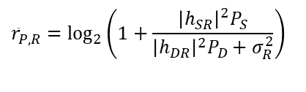


System model
Received signals
At the hidden receiver $R$
Channel capacity for the public message by treating the covert message as interference (if $r_{P}≤{\overline{r}}_{P,R}$)
$$y_{R}=h_{SR}\sqrt{P_{S}}x_{P}+h_{DR}\sqrt{P_{D}}x_{C}+z_{R}$$
$${\bar{r}}_{P,R}=\log_{2}\left(1+\frac{{\left|h_{SR}\right|}^{2}P_{S}}{{\left|h_{DR}\right|}^{2}P_{D}+σ_{R}^{2}}\right)$$
Public message, $x_{P}$
Covert message, $x_{C}$
Source, S
Hidden
receiver, R
Disguised FD destination, D

Slide 11


System model
Received signals
At the hidden receiver $R$
Achievable rate for the covert message after canceling the decoded public message
$$y_{R}=h_{SR}\sqrt{P_{S}}x_{P}+h_{DR}\sqrt{P_{D}}x_{C}+z_{R}$$
$$r_{C,R}=\log_{2}\left(1+\frac{{\left|h_{DR}\right|}^{2}P_{D}}{σ_{R}^{2}}\right)$$
Public message, $x_{P}$
Covert message, $x_{C}$
Source, S
Hidden
receiver, R
Disguised FD destination, D

Slide 12

Problem Formulation
Covert rate maximization:
We formulate a covert rate maximization problem as
$$P1) : \underset{P_{D},r_{P}}{\underbrace{max}} r_{C,R}$$
$Subject to :r_{P}≤ {\overline{r}}_{P,R}$
$r_{P}≤ {\overline{r}}_{P,D}$
$r_{P}≥ {\overline{r}}_{P}$
$\operatorname{Pr}\left(e\right){\left.​\right|}_{τ=τ^{∗}}≥ ϵ$
$ζ{{\overline{σ}}^{2}}_{W}≥{\left|h_{DW}\right|}^{2}P_{D}+\frac{1}{ζ}$ ${{\overline{σ}}^{2}}_{W}$
$0≤P_{D}≤ {\overline{P}}_{D}$

Slide 13
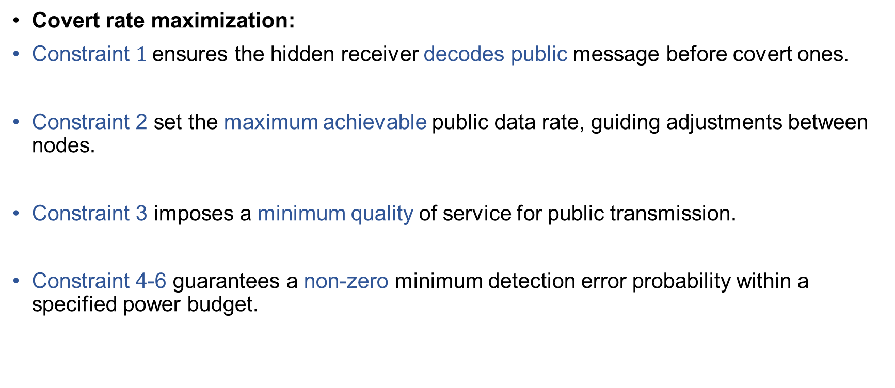
Problem Formulation
Covert rate maximization:
Constraint $1$ensures the hidden receiver decodes public message before covert ones.
Constraint 2 set the maximum achievable public data rate, guiding adjustments between nodes.
Constraint 3 imposes a minimum quality of service for public transmission.
Constraint 4-6 guarantees a non-zero minimum detection error probability within a specified power budget.

Slide 14



Problem Formulation
Covert message detection
At the warden W
$y_{W}=h_{SW} \sqrt{P_{S}} x_{P}+h_{DW} \sqrt{P_{D}} x_{C}+z_{W}$
Public message, $x_{P}$
Covert message, $x_{C}$
Source, S
Warden, W
Disguised FD destination, D

Slide 15
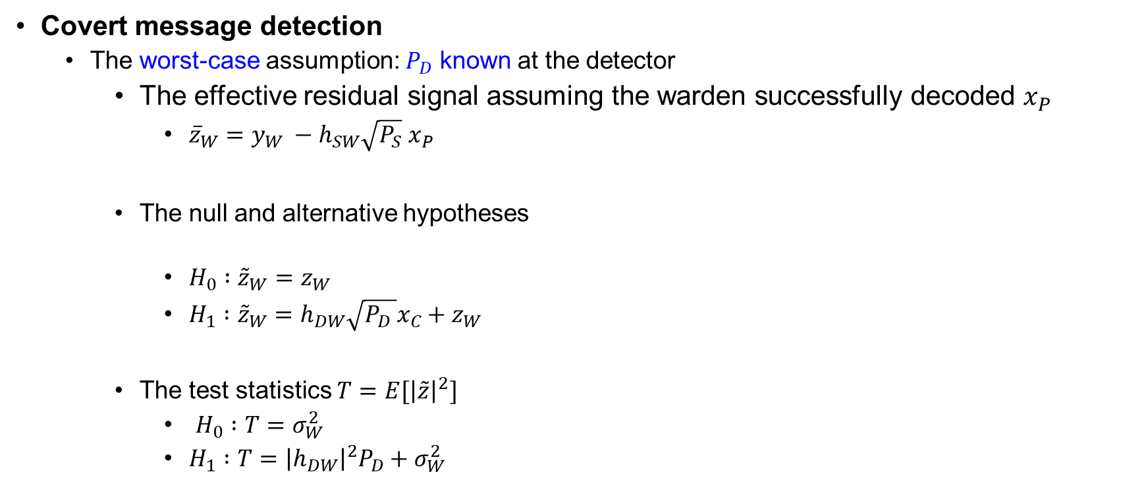
Problem Formulation
Covert message detection
The worst-case assumption: $P_{D}$ known at the detector
The effective residual signal assuming the warden successfully decoded $x_{P}$
${\overline{z}}_{W}=y_{W} −h_{SW}\sqrt{P_{S}} x_{P}$
The null and alternative hypotheses
$H_{0} :{\tilde{z}}_{W}=z_{W}$
$H_{1} :{\tilde{z}}_{W}=h_{DW}\sqrt{P_{D} }x_{C}+z_{W}$
The test statistics $T=E[{\left|\tilde{z}\right|}^{2}]$
$H_{0} :T=σ_{W}^{2}$
$H_{1} :T={\left|h_{DW}\right|}^{2}P_{D}+σ_{W}^{2}$

Slide 16
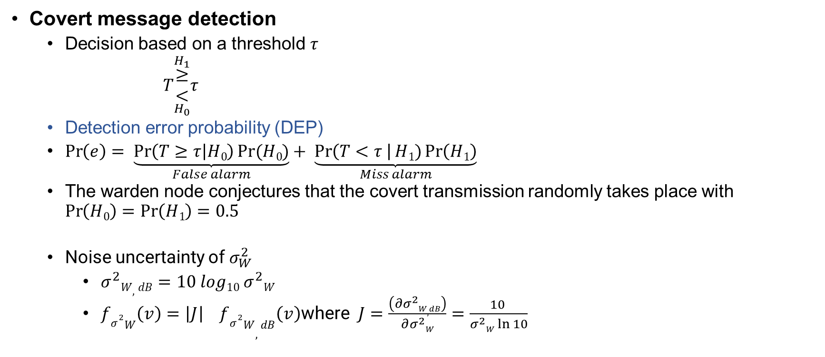
Problem Formulation
Covert message detection
Decision based on a threshold $τ$
$T\begin{matrix}\overset{H_{1}}{≥} \\ \underset{H_{0}}{<}\end{matrix}τ$
Detection error probability (DEP)
$\operatorname{Pr}\left(e\right)= \underset{False alarm}{\underbrace{\operatorname{Pr}\left(T≥τ | H0\right)Pr⁡(H0)}}+ \underset{Miss alarm}{\underbrace{\operatorname{Pr}\left(T<τ \right|H1)\operatorname{Pr}\left(H1\right)}}$
The warden node conjectures that the covert transmission randomly takes place with $\operatorname{Pr}\left(H0\right)=\operatorname{Pr}\left(H1\right)=0.5$
Noise uncertainty of $σ_{W}^{2}$
$σ^{2}W,dB=10 log10{ σ}^{2}W$
$fσ^{2}W\left(v\right)=\left|J\right| fσ^{2}W,dB\left(v\right)$where $J=\frac{\left(∂σ^{2}W,dB\right)}{∂σ^{2}W}=\frac{10 }{σ^{2}W\ln{10}}$

Slide 17

Problem Formulation
Covert message detection
Noise uncertainty of $σ_{W}^{2}$
PDF of $σ^{2}W$
$fσ^{2}W\left(v\right)= \frac{10}{vln10}∗ \frac{1}{2ζdB}=\frac{10}{v ln10}∗\frac{1}{2 ∗ 10log10ζ}=\frac{1}{2lnζ∗v}$
CDF of $σ^{2}W$
$\text{F}σ^{2}W\left(v\right)= \int_{\frac{{\bar{σ}}_{W}^{2}}{ζ}}^{v}{ fσ^{2}W\left(v\right) dv= \frac{1}{2lnζ}[lnv−ln\frac{{\bar{σ}}_{W}^{2}}{ζ}]}$
F$σ^{2}W\left(v\right)=\frac{1}{lnζ} \left(lnv −\ln{\frac{{\bar{σ}}_{W}^{2}}{ζ}}\right), v∈[\frac{{\bar{σ}}_{W}^{2}}{ζ}, ζ{\bar{σ}}_{W}^{2}]$

Slide 18
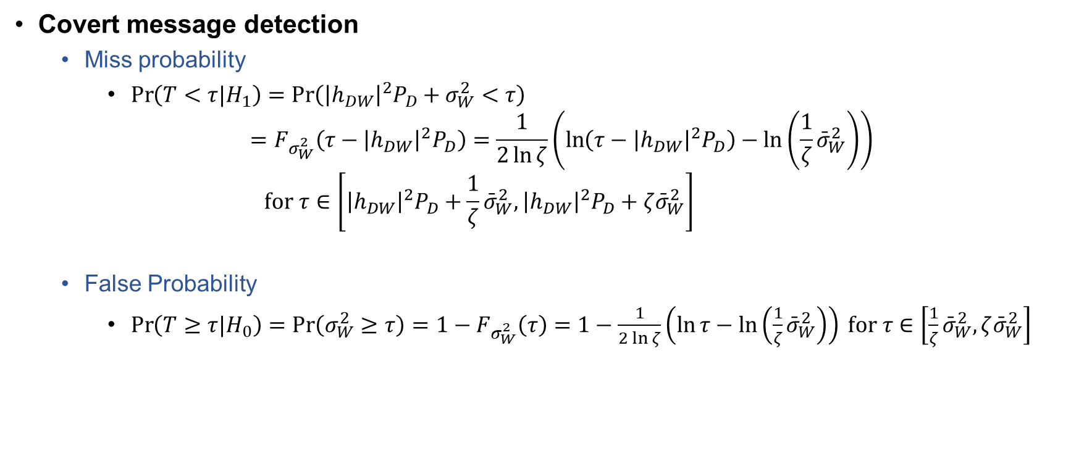
Problem Formulation
Covert message detection
Miss probability
$\operatorname{Pr}\left(T<τ|H_{1}\right)=\operatorname{Pr}\left({\left|h_{DW}\right|}^{2}P_{D}+σ_{W}^{2}<τ\right)$ $=F_{σ_{W}^{2}}\left(τ−{\left|h_{DW}\right|}^{2}P_{D}\right)=\frac{1}{2\ln{ζ}}\left(\ln\left(τ−{\left|h_{DW}\right|}^{2}P_{D}\right)−\ln\left(\frac{1}{ζ}{\bar{σ}}_{W}^{2}\right)\right)$ $\text{for} τ∈\left[{\left|h_{DW}\right|}^{2}P_{D}+\frac{1}{ζ}{\bar{σ}}_{W}^{2},{\left|h_{DW}\right|}^{2}P_{D}+ζ{\bar{σ}}_{W}^{2}\right]$
False Probability
$\operatorname{Pr}\left(T≥τ|H_{0}\right)=\operatorname{Pr}\left(σ_{W}^{2}≥τ\right)=1−F_{σ_{W}^{2}}\left(τ\right)=1−\frac{1}{2\ln{ζ}}\left(\ln{τ}−\ln\left(\frac{1}{ζ}{\bar{σ}}_{W}^{2}\right)\right) \text{for} τ∈\left[\frac{1}{ζ}{\bar{σ}}_{W}^{2},ζ{\bar{σ}}_{W}^{2}\right]$

Slide 19
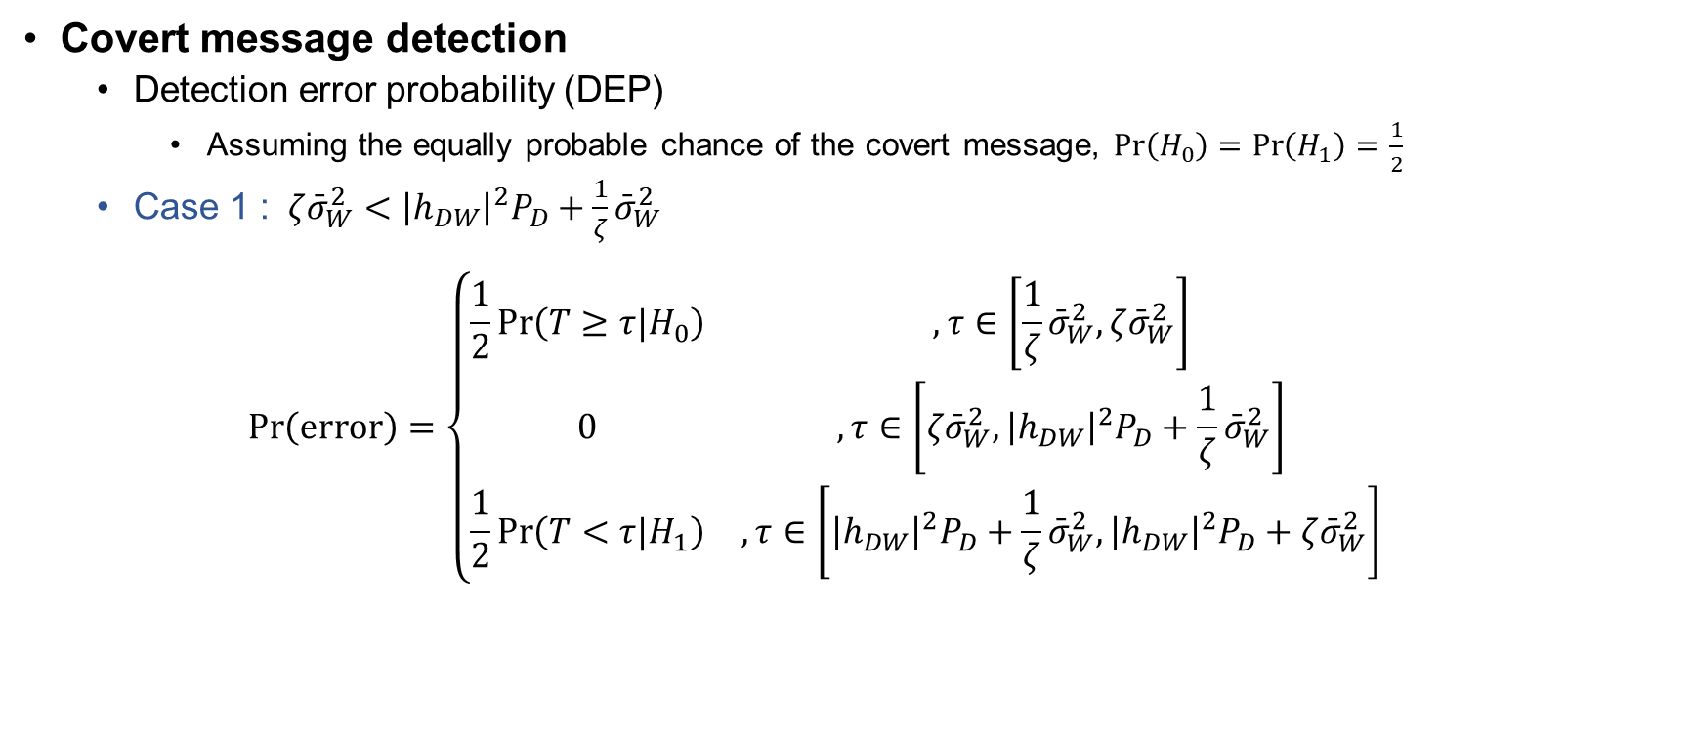
Problem Formulation
Covert message detection
Detection error probability (DEP)
Assuming the equally probable chance of the covert message, $\operatorname{Pr}\left(H_{0}\right)=\operatorname{Pr}\left(H_{1}\right)=\frac{1}{2}$
Case 1 : $ζ{\bar{σ}}_{W}^{2}<{\left|h_{DW}\right|}^{2}P_{D}+\frac{1}{ζ}{\bar{σ}}_{W}^{2}$
$$\operatorname{Pr}\left(\text{error}\right)=\left\{\begin{matrix}\frac{1}{2}\operatorname{Pr}\left(T≥τ|H_{0}\right) & , τ∈\left[\frac{1}{ζ}{\bar{σ}}_{W}^{2},ζ{\bar{σ}}_{W}^{2}\right] \\ 0 & , τ∈\left[ζ{\bar{σ}}_{W}^{2},{\left|h_{DW}\right|}^{2}P_{D}+\frac{1}{ζ}{\bar{σ}}_{W}^{2}\right] \\ \frac{1}{2}\operatorname{Pr}\left(T<τ|H_{1}\right) & , τ∈\left[{\left|h_{DW}\right|}^{2}P_{D}+\frac{1}{ζ}{\bar{σ}}_{W}^{2},{\left|h_{DW}\right|}^{2}P_{D}+ζ{\bar{σ}}_{W}^{2}\right]\end{matrix}\right.$$

Slide 20

Problem Formulation
Covert message detection
Detection error probability (DEP)
Assuming the equally probable chance of the covert message, $\operatorname{Pr}\left(H_{0}\right)=\operatorname{Pr}\left(H_{1}\right)=\frac{1}{2}$
Case 2 : $ζ{\bar{σ}}_{W}^{2}≥{\left|h_{DW}\right|}^{2}P_{D}+\frac{1}{ζ}{\bar{σ}}_{W}^{2}$
$$\operatorname{Pr}\left(\text{error}\right)=\left\{\begin{matrix}\frac{1}{2}\operatorname{Pr}\left(T≥τ|H_{0}\right) & , τ∈\left[\frac{1}{ζ}{\bar{σ}}_{W}^{2},{\left|h_{DW}\right|}^{2}P_{D}+\frac{1}{ζ}{\bar{σ}}_{W}^{2}\right] \\ \frac{1}{2}\left(\operatorname{Pr}\left(T≥τ|H_{0}\right)+\operatorname{Pr}\left(T<τ|H_{1}\right)\right) & , τ∈\left[{\left|h_{DW}\right|}^{2}P_{D}+\frac{1}{ζ}{\bar{σ}}_{W}^{2},ζ{\bar{σ}}_{W}^{2}\right] \\ \frac{1}{2}\operatorname{Pr}\left(T<τ|H_{1}\right) & , τ∈\left[ζ{\bar{σ}}_{W}^{2},{\left|h_{DW}\right|}^{2}P_{D}+ζ{\bar{σ}}_{W}^{2}\right]\end{matrix}\right.$$

Slide 21











Problem Formulation
Covert message detection
The shape of the DEP function
Case 1 : $ζ{\bar{σ}}_{W}^{2}<{\left|h_{DW}\right|}^{2}P_{D}+\frac{1}{ζ}{\bar{σ}}_{W}^{2}$
$$\operatorname{Pr}\left(\text{error}\right)$$
$$\frac{1}{2}$$
Maximum error
= A random guess
$$\frac{1}{2}\operatorname{Pr}\left(T≥τ|H_{0}\right)$$
$$\frac{1}{2}\operatorname{Pr}\left(T<τ|H_{1}\right)$$
$$0$$
$$τ$$
$$0$$
$$\frac{1}{ζ}{\bar{σ}}_{W}^{2}$$
$$ζ{\bar{σ}}_{W}^{2}$$
$${\left|h_{DW}\right|}^{2}P_{D}+\frac{1}{ζ}{\bar{σ}}_{W}^{2}$$
$${\left|h_{DW}\right|}^{2}P_{D}+ζ{\bar{σ}}_{W}^{2}$$

Slide 22

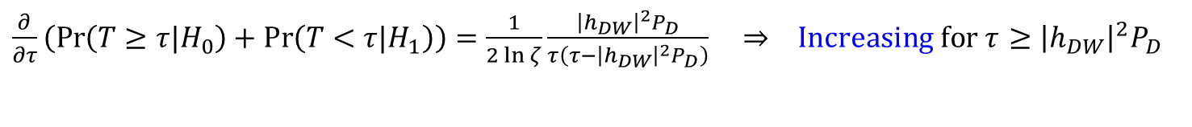
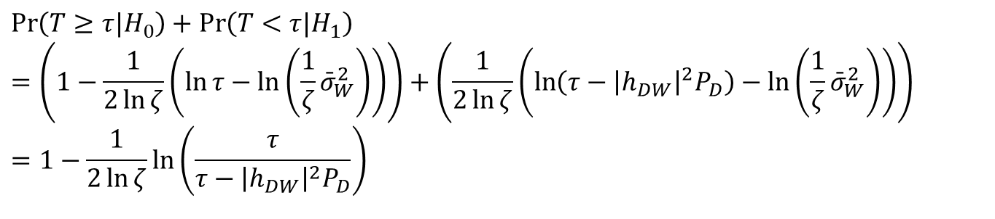
Problem Formulation
Covert message detection
The shape of the DEP function
Case 2 : $ζ{\bar{σ}}_{W}^{2}≥{\left|h_{DW}\right|}^{2}P_{D}+\frac{1}{ζ}{\bar{σ}}_{W}^{2}$
Note that
The first derivative
$$\operatorname{Pr}\left(T≥τ|H_{0}\right)+\operatorname{Pr}\left(T<τ|H_{1}\right) \\ =\left(1−\frac{1}{2\ln{ζ}}\left(\ln{τ}−\ln\left(\frac{1}{ζ}{\bar{σ}}_{W}^{2}\right)\right)\right)+\left(\frac{1}{2\ln{ζ}}\left(\ln\left(τ−{\left|h_{DW}\right|}^{2}P_{D}\right)−\ln\left(\frac{1}{ζ}{\bar{σ}}_{W}^{2}\right)\right)\right) \\ =1−\frac{1}{2\ln{ζ}}\ln\left(\frac{τ}{τ−{\left|h_{DW}\right|}^{2}P_{D}}\right)$$
$\frac{∂}{∂τ}\left(\operatorname{Pr}\left(T≥τ|H_{0}\right)+\operatorname{Pr}\left(T<τ|H_{1}\right)\right)=\frac{1}{2\ln{ζ}}\frac{{\left|h_{DW}\right|}^{2}P_{D}}{τ\left(τ−{\left|h_{DW}\right|}^{2}P_{D}\right)} ⇒ \text{Increasing} \text{for} τ$ $≥{\left|h_{DW}\right|}^{2}P_{D}$

Slide 23






Problem Formulation
Covert message detection
The shape of the DEP function
Case 2 : $ζ{\bar{σ}}_{W}^{2}≥{\left|h_{DW}\right|}^{2}P_{D}+\frac{1}{ζ}{\bar{σ}}_{W}^{2}$
$$\operatorname{Pr}\left(\text{error}\right)$$
$$\frac{1}{2}$$
$$\frac{1}{2}\operatorname{Pr}\left(T≥τ|H_{0}\right) \\ +\frac{1}{2}\operatorname{Pr}\left(T<τ|H_{1}\right)$$
Maximum error
= A random guess
$$\frac{1}{2}\operatorname{Pr}\left(T≥τ|H_{0}\right)$$
$$\frac{1}{2}\operatorname{Pr}\left(T<τ|H_{1}\right)$$
$$0$$
$$τ$$
$$0$$
$$\frac{1}{ζ}{\bar{σ}}_{W}^{2}$$
$${\left|h_{DW}\right|}^{2}P_{D}+\frac{1}{ζ}{\bar{σ}}_{W}^{2}$$
$$ζ{\bar{σ}}_{W}^{2}$$
$${\left|h_{DW}\right|}^{2}P_{D}+ζ{\bar{σ}}_{W}^{2}$$

Slide 24


Problem Formulation
Covert message detection
The minimum DEP and the optimal threshold $τ^{⋆}$
$$τ^{★}=\underset{τ}{argmin}\operatorname{Pr}\left(\text{error}\right)={\left|h_{DW}\right|}^{2}P_{D}+\frac{1}{ζ}{\bar{σ}}_{W}^{2} \\ \operatorname{minPr}\left(\text{error}\right)=\left\{\begin{matrix}0 & , ζ{\bar{σ}}_{W}^{2}<{\left|h_{DW}\right|}^{2}P_{D}+\frac{1}{ζ}{\bar{σ}}_{W}^{2} \\ \frac{1}{2}\left(1−\frac{1}{2\ln{ζ}}\left(\ln{\frac{τ^{★}}{τ^{★}−{\left|h_{DW}\right|}^{2}P_{D}}}\right)\right) & , ζ{\bar{σ}}_{W}^{2}≥{\left|h_{DW}\right|}^{2}P_{D}+\frac{1}{ζ}{\bar{σ}}_{W}^{2}\end{matrix}\right.$$

Slide 25

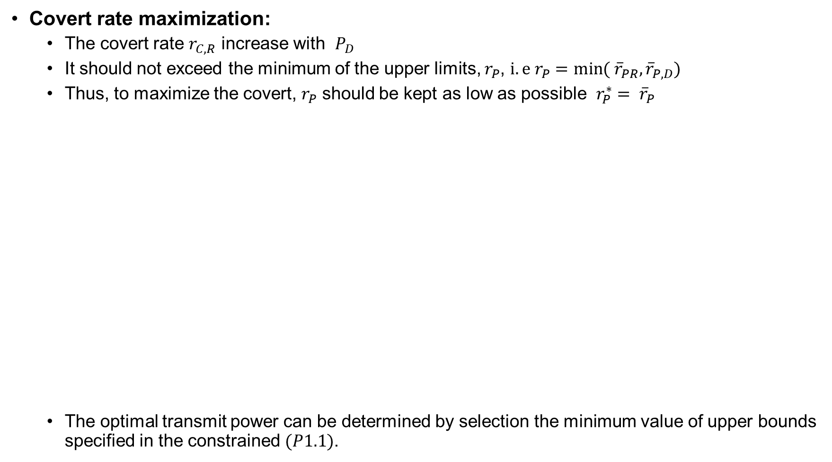
Proposed Solution
Covert rate maximization:
The covert rate $r_{C,R}$ increase with $P_{D}$
It should not exceed the minimum of the upper limits, $r_{P}$, $i.e r_{P}=\min{( {\overline{r}}_{PR},{\overline{r}}_{P,D}})$
Thus, to maximize the covert, $r_{P}$ should be kept as low as possible $r_{P}^{∗}= {\overline{r}}_{P}$
The optimal transmit power can be determined by selection the minimum value of upper bounds specified in the constrained $(P1.1)$.
$$\left(P1.1\right): \underset{P_{D}}{\underbrace{max}} P_{D}$$
$Subject to : P_{D}≤\frac{1}{{\left|h_{DR}\right|}^{2}} \left(\frac{{\left|h_{SR}\right|}^{2}P_{S}}{2^{{\overline{r}}_{P}} −1} −σ_{R}^{2}\right)$
${ P}_{D}≤\frac{1}{{\left|{\tilde{h}}_{DD}\right|}^{2}}(\frac{{\left|h_{SD}\right|}^{2}P_{S}}{2^{{\overline{r}}_{P}} −1} −σ_{D}^{2})$
$P_{D}≤\left(ζ^{1−4ε} −\frac{1}{ζ}\right)\frac{{\bar{σ}}_{W}^{2}}{{\left|h_{DW}\right|}^{2}}$
$P_{D}≤ \left(ζ −\frac{1}{ζ}\right) \frac{{\bar{σ}}_{W}^{2}}{{\left|h_{DW}\right|}^{2}}$
$0≤P_{D}≤ {\overline{P}}_{D}$

Slide 26
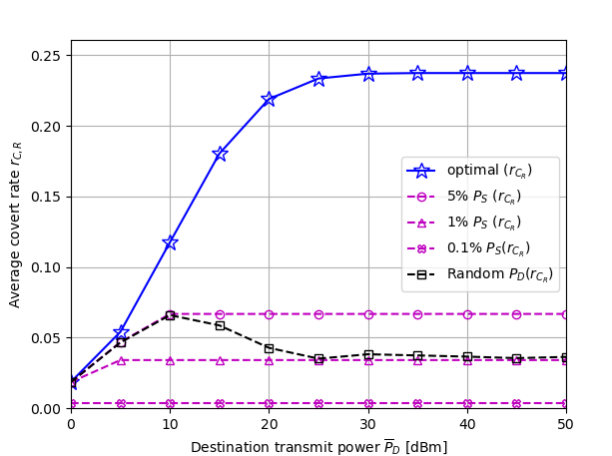
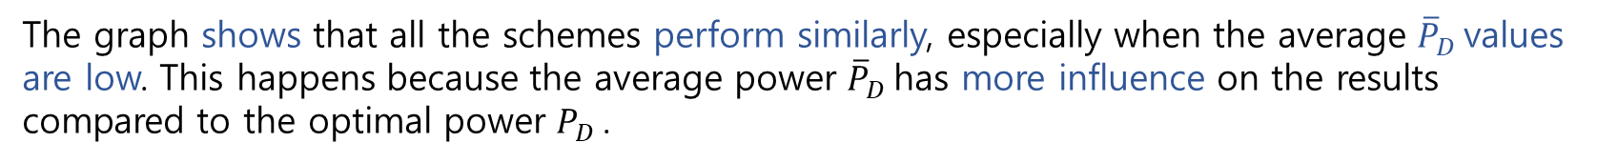
Numerical Results
Figure 2. Covert rate vs destination power budget
The graph shows that all the schemes perform similarly, especially when the average ${\overline{P}}_{D}$values are low. This happens because the average power ${\overline{P}}_{D}$has more influence on the results compared to the optimal power $P_{D}$.

Slide 27
Conclusions
Studied a covert communications system:
Source node communicates with a disguised FD destination node.
Destination node, supposedly receive-only, covertly delivers critical messages.
Messages are sent to another hidden receiver while avoiding detection by a warden node.
Identified optimal parameters:
Determined the optimal public data rate.
Found the transmit power of the FD destination node that maximizes covert rate at the hidden receiver.

Slide 28
Thank you for your Listening. For any queries, please email me at: refatkhanuits@gmail.com

